Slide 1
The PIC microcontroller
PIC18F4520: IO Port Programming

Slide 2
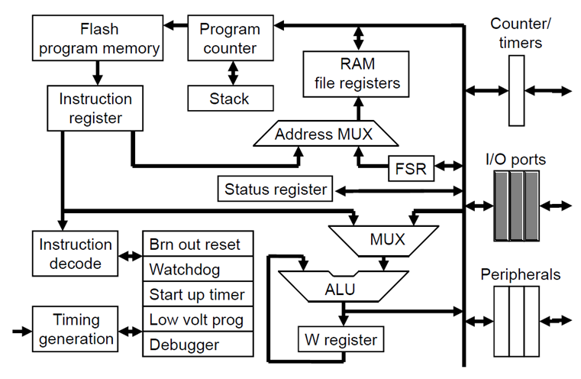
PIC18F: Controller Architecture

Slide 3
PIC18F: Notational convention
WREG
W Register
FREG
File Register (any register location from GPR Bank 0 / SFR)
[X]
Contents of register X
[WREG] = 0x02 ↔ WREG’s contents become 0x02
[0x20] = 0x34 ↔ RAM File Register 0x20 content becomes 0x34
[X] = [Y] ↔ Contents of Y are copied into X
Number systems
Decimal | d’10’
Hexadecimal | h’4A’ or 0x4A
Binary | b’1000 0010’

Slide 4
Digital i/o ports

Slide 5
Electronics: Concept of I/O Ports
Interfacing with the real world
Digital devices – using digital I/O ports
1/2/3-pin devices – using I/O port pins
Serial devices – using I/O port pins or serial ports
Parallel devices – using I/O port pins in parallel
Analog devices – using analog input channels and ADCs
Digital devices
Talk ‘digital’ – the language of 1’s and 0’s
Voltages:
Logic high (1): 5V, 3.3V, 1.8V, …
Logic low (0): 0V

Slide 6
PIC18F family: I/O port wise

Slide 7
PIC18F: I/O ports
PIC18F4520 has 5 Digital Bidirectional I/O ports
Port function multiplexed with other functions
Labelled alphabetically
PORTA, PORTB, PORTC, PORTD (8-bits each)
PORTE (4-bits)
Pin-out wise, the pins are named RXn
I/O Port | Port pin(s)
PORTA | RA0 – RA7
PORTB | RB0 – RB7
PORTC | RC0 – RC7
PORTD | RD0 – RD7
PORTE | RE0 – RE3

Slide 8
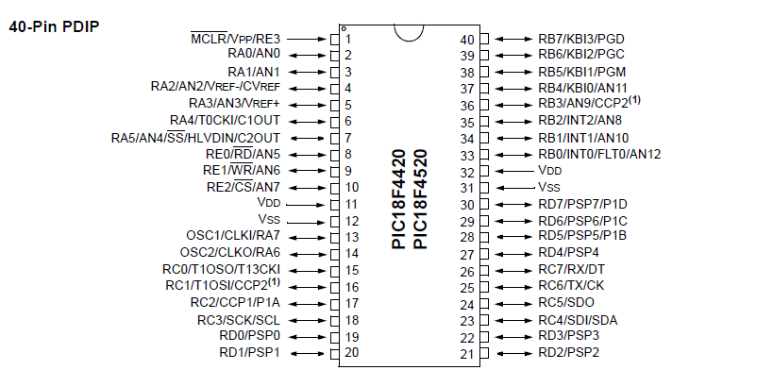
PIC18F4520: I/O ports in the pin-out

Slide 9
PIC18F: I/O port usage
Being a soft-configured controller
Port pin functionality needs to be coded
Port pin direction also needs to be coded
Each PORT has 3 port registers for interaction and control
TRIS (tristate) register
Controls port/pin direction
On a per-pin basis, 1 makes it input, 0 makes it output
PORT register
Exchange of data with device connected to the port
LAT (latch) register
Used for read-modify-write operations – not used in this course

Slide 10
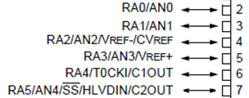

PIC18F4520: PORT A details
PORT A
Port size (width)
8 bits
Pins
RA0 – RA7
Registers (reside in the SFR!)
Direction
TRISA – 8-bit
Data
PORTA – 8-bit
Latch
LATA – 8-bit
PORTA
7
6
5
4
3
2
1
0
data
TRISA
7
6
5
4
3
2
1
0
direction

Slide 11
PIC18F: Using I/O PORT B
Schematic lookup
Peruse schematic and confirm connections involving PORTB
Determine data flow direction (input / output)
Algorithmic decision
Determine how you will use PORTB for interaction
Incorporate timing considerations, if any
Coding
Set up pin / port direction(s) by writing value(s) to TRISB
Perform data transfer(s) by reading/writing to PORTB

Slide 12

PIC18F: PORTB as an output port
Consider this code MOVLW b’00000000’
MOVWF TRISB
LOOP MOVLW 0x55
MOVWF PORTB
CALL DELAY
MOVLW 0xAA
MOVWF PORTB
CALL DELAY
BRA LOOP
‘User’ view of the PIC
PIC18F4520
WREG
PORTB
What does this code do?
Called ‘port-wise’ usage of PORTB

Slide 13
PIC18F: PORTB pin(s) as output
Consider this code
BCF TRISB, 0
LOOP BSF PORTB, 0
CALL DELAY
BCF PORTB, 0
CALL DELAY
BRA LOOP
‘User’ view of the PIC
PIC18F4520
RB0
Called ‘pin-wise’ usage of PORTB

Slide 14
PIC18F: PORTB as an input port
Consider this code
INREG EQU 0x20
MOVLW b’11111111’
MOVWF TRISB
MOVF PORTB, W
MOVWF INREG
‘User’ view of the PIC
PIC18F4520
WREG
PORTB
DEVICE
INREG
Called ‘port-wise’ usage of PORTB

Slide 15
PIC18F: PORTB pin(s) as input
Consider this code
BSF TRISB, 2
LOOP BTFSS PORTB, 2
BRA LOOP
…
‘User’ view of the PIC
PIC18F4520
Algo
RB2
1-pin DEVICE
Called ‘pin-wise’ usage of PORTB

Slide 16
Real-world scenarios

Slide 17
Scenario #1: Implement festive lights!
Problem statement
Assume 8 LEDs are attached to all 8 pins of PORTB
Create a pattern where each LED lights up after a delay
Think!
PORTB access method: port-wise / pin-wise
PORTB direction: input / output

Slide 18
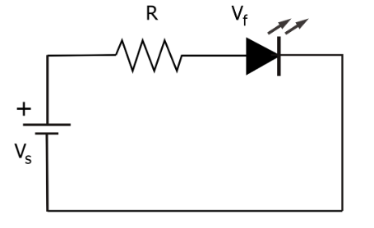
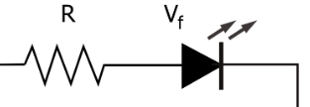
Scenario #1: Circuit schematic
LED working principle
LEDs in our scenario
PIC18F4520
PORTB
…
For LED to ‘light up’, the anode needs to have a high positive voltage (> V_{f} )

Slide 19
Scenario #1: Code
CLRF TRISB ; Make all pins output
BSF PORTB, 0 ; RA0 LED
CALL DELAY
BSF PORTB, 1 ; RA1 LED
CALL DELAY
…
BSF PORTB, 7 ; RA7 LED

Slide 20
Scenario #1: Twist!
What would happen:
If we used a ‘port-wise’ access method for PORTB?
CLRF TRISB ; Make all pins output
MOVLW 0xFF ; Fill with all ones
MOVWF PORTB ; Push to PORTB
Which problem statement does this code solve?

Slide 21
Scenario #2: Making waves!
Problem statement
Create a ‘regular’ square wave on pin RC0 of PORTC
Think!
‘Regular’ square wave → duty cycle is 50%
Equal t_{ON} and t_{OFF} times → t_{ON} = t_{OFF}
We could use a BTG (bit toggle) instruction!
Square wave properties
t_{OFF}
t_{ON}
T = Period = t_{ON} + t_{OFF}
f = Frequency
T
f = 1 / T

Slide 22
Scenario #2: Code for square wave
BCF TRISC, 0 ; Make this pin output
LOOP BTG PORTC, 0 ; Toggle away
CALL DELAY ; Delay for some time
BRA LOOP ; Repeat
How would the code change if we used BSF, BCF?

Slide 23
Scenario #3: Making uneven waves!
Problem statement
Create a square wave of DC 66% on pin RD3
Think!
DC 66% → 66% ON, rest of the time (~33%) OFF
66:33 → 2:1 → t_{ON} = 2 * t_{OFF}
Can we use a BTG (bit toggle) instruction here?
t_{OFF}
PWM Square wave properties
t_{ON}
T = Period = t_{ON} + t_{OFF} = 3 * t_{OFF}
f = Frequency
T
f = 1 / T

Slide 24
Scenario #3: Code for 66% DC
BCF TRISD, 3 ; make this pin output
LOOP BSF PORTD, 3 ; ON
CALL DELAY ; for
CALL DELAY ; 2 times!
BCF PORTD, 3 ; OFF
CALL DELAY ; for
BRA LOOP ; (only) 1 time!
How does this code change if DC needed is 33%?
How about DC of 15%?!

Slide 25
Scenario #4: Multiple devices
Problem statement
Keep monitoring a 1-pin device connected to RB4
if
it goes HIGH
then
send a byte 0x45 to an (8-pin) device connected to PORTC
send a HIGH-to-LOW pulse to a 1-pin device connected to RA2
Think!
Ports?
Access methods for each such port?
Port directions?

Slide 26
Scenario #4: Circuit schematic
Input as well as output devices!
if
then
PIC18F4520
Algo
PORTC
0x45
DEVICE
1-pin DEVICE
RB4
RA2
1-pin DEVICE

Slide 27
Scenario #4: Code
BSF TRISB, 4 ; input – pin-wise
CLRF TRISC ; output – port-wise
BCF TRISA, 2 ; output – pin-wise
MOVLW 0x45 ; data pre-load
LOOP BTFSS PORTB, 4 ; check!
BRA LOOP
MOVWF PORTC ; move byte
BSF PORTA, 2 ; HIGH
BCF PORTA, 2 ; then LOW

Slide 28
PIC18F: I/O Ports Summary
What are I/O Ports
PIC18F
Nature of I/O ports
TRIS, PORT and LAT registers
Access methods: ‘port-wise’, ‘pin-wise’
Port directions
Square wave generation
Changing DC and deriving PWM
Simple ratios
Interfacing multiple devices
Code for handling if-then-else loops

Slide 29
Thank you!

